Slide 1
Acai You Later
Acai You Later
Ajani Bryant, Anvitha Chaluvadi, Raja Hussain, & Sameer Khan

Slide 2
Who Are We?
Overall Business
Business Objective
Serving custom Acaí bowls to customer preference
To introduce a new blend of Acaí bowls to various communities using local organic resources

Slide 3
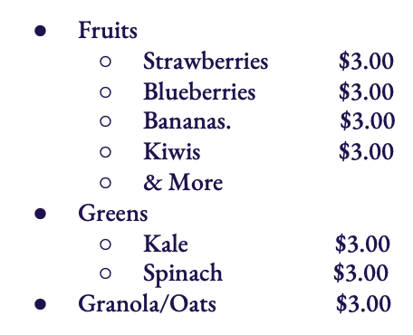
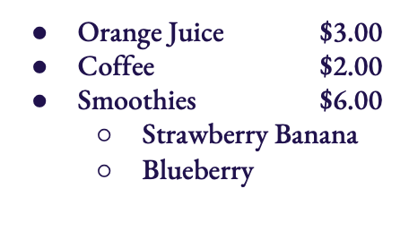
Menu
Make Your Own Bowl
Bowl
Toppings
Drinks
Sizes (Choose 1)
Small (3 toppings)
Large (4 toppings)
Fruit Base (Choose 1)
Strawberry $3.00
Blueberry $3.00
Bananas $3.00

Slide 4
Marketing Strategies
How will we make ourselves known to the public?
1
2
3
4
Create Website
Utilizing Directory Platforms
Presence On Social Media
Attend/Host Events

Slide 5
Database Design
For our database design we began with three tables containing the following information:
1
2
3
Customer
Menu
Order
Customer ID
First Name
Last Name
Phone Number
Email Address
Customer ID
Menu Item
Quantity
Cost Per Item
Total Cost
Customer ID
Date of Order
Time of Order
Order ID

Slide 6
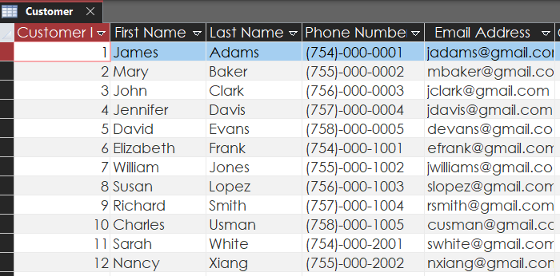
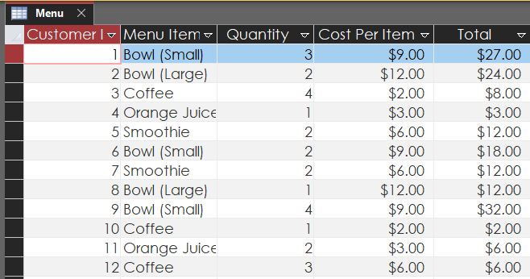
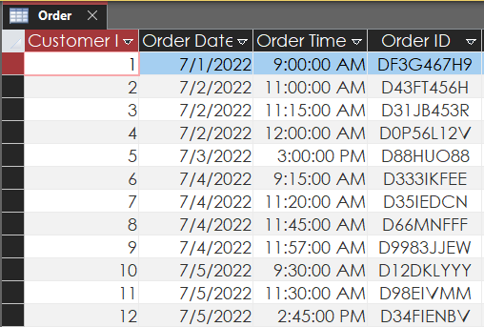
Database Design Cont.
1
2
3

Slide 7
Database Queries
Two queries we created that focused on answering two questions:
1
2
Most Popular Menu Items
Most Popular Order Times
Decipher what menu items were most popular
By selecting both menu items and the order quantity
Sorting it alphabetically to get a sum for each item
Allow us to understand
What items are selling at a faster rate
What we need to stock more of, or less of
Possibly modify our menu in the future
Determine the most popular order times.
Sorted order time in ascending order to find times with the most business flow
We can plan for the heaviest volume times
Allow us to understand
The most popular order times
Have enough staffing

Slide 8
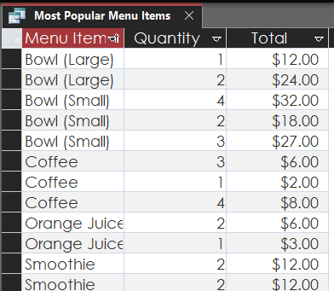
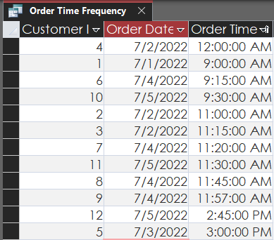
Database Queries Cont.
1
2

